Slide 1
Measuring social impact: Challenges and benefits of alternative methods of measuring social impact
Les Hems, Director of Research,
Centre for Social Impact, University of new South Wales
Professor Paul Flatau, Centre for Social Impact, University of Western Australia
Australasian Evaluation Society Conference
2nd September 2011 - Sydney

Slide 2
Measuring Social Impact and evaluation
Shared goal: Seeking to find out what works – and why
Evaluation plays a key role in measuring social impact
The treatment effect - effectiveness
Cost benefit analysis, value for money, proxy measures etc.
Counterfactual – what would have happened without an intervention / implementation of a program?
Measuring social impact enhances evaluations
Enhances reporting and articulation of evaluations
Differences
Externally or internally commissioned

Slide 3
Why measure and evaluate Social Impact?
Not –for-profit organisations:
Improve organisational performance – a learning organisation
Assess relationship between mission and activities
Ensure scarce resources are being used to most effect
Engage with diverse stakeholders
Increase accountability and maintain public trust
Raise public profile – reputational value
Exhibit to benefactors the social impact related to their “investment” – including volunteers

Slide 4
Why measure and evaluate Social Impact?
Others:
Ensure scarce resources are being used to most effect – government funding, philanthropic institution grants, donations by high net worth individuals.
Move from grant to short term contract based relationships between government and not-for-profit organisations has not delivered better outcomes or value for money.
Facilitate the development of Governments’ use of outcome based commissioning
Facilitate the development of innovative social finance mechanisms such as Social Impact Bonds
Method of engaging corporates – community involvement programs, corporate social investment
Encourage better reporting and increase accountability

Slide 5
Context for measurement
Purpose Demonstrate social impact (QUALITATIVE)
Measure value of social impact
(QUANTITATIVE)
Measurement levels Project or program
Organisation
System – Field of activity
Community
Nature of impact Direct
Indirect
(iv) Retrospective or Evaluation, diagnosis, report
Predictive (but needs Forecast, plan, monitor
to be longitudinal)

Slide 6
The component parts of measurement
Inputs : Resources used
Activities : The work undertake
Outputs : The things produced
Outcomes : Net benefit to recipients
intended results
attributable to activities
Impact : Net benefit to broader community
often long-term
including unintended ‘spillover’ effects

Slide 7
Principles and methods
“As to methods there may be a million and then some, but principles are few. The man who grasps principles can successfully select his own methods. The man who tries methods, ignoring principles, is sure to have trouble.”
Ralph Waldo Emerson, 19th Century American philosopher

Slide 8
Key principles for measurement
Tightly defined purpose - mission and objectives
Engage all relevant stakeholders - iteratively
Understand the change you are seeking to achieve
Measure and prioritise the things that matter
Do not over claim
Be transparent – both purpose and measurement
Verify the impact you are claiming

Slide 9
1. Define purpose
Mission – what are you trying to achieve - the long term goal that describes the net benefit to society
Define scope – to provide a boundary
Hierarchy of objectives – the strategy to achieve the mission
Targets and metrics – how you know you are meeting your objectives and achieving your mission – and how you know you are targeting those most in need

Slide 10
2. Engage stakeholders
Stakeholder mapping – categorise and prioritise
Who they are
What they contribute
What they influence
What are their expectations – performance = level of satisfaction of stakeholder’s expectations
Each stakeholder’s expectations are different:
Impact, change, targets achieved, equity, value for money, efficiency, progress / milestones met, economy

Slide 11
3. Understand the changes you are seeking
Develop a “theory of change”
Develop a narrative of the process of change that is needed to achieve desired impact.
Maximise the utility of existing evaluations
Iterative consultative dialogue with stakeholders
Agree hierarchy of objectives
Social, environmental and economic impacts
Positive and negative impacts
Attribution of change to each stakeholder

Slide 12
4. Measure and prioritise the things that matter
Identify metrics that best measure the desired change: inputs, activities, outputs, and outcomes
Develop benchmarks and comparators – internal and external
Develop financial proxies to recognise value of non-financial outcomes
Develop mechanism to combine the value of financial and non-financial value
Ensure you have metrics that cover economy, efficiency, effectiveness
Determine what information and evidence must be included to give a “true and fair” picture - based on whether a different decision could be made if information is excluded e.g. use of assumptions

Slide 13
5. Do not over claim
Only claim the value that the organisation / case is responsible for creating - attribution.
Recognise contribution of other stakeholders.
Recognise what would have happened anyway.
Evidence value created using a benchmark and trends.

Slide 14
6. Be transparent
Articulate the linkages between purpose, stakeholders, theory of change - inputs, outputs, outcomes and impact
Explain metrics used: inputs, outputs, outcomes, proxies, benchmarks and targets.
Describe methods of data collection, sources used, evidence, analysis and trends.

Slide 15
7. Verify the measurement
There is value in seeking independent assurance – internal or external
The process includes subjectivity and complex decision-making.
Assurance by independent “qualified” individual or organisation

Slide 16
The dangers of measurement
Takes up scarce resources
Difficulty of measuring intangible contribution – subjectivity may undermine confidence in measurement
May focus activity on the measurable – precision without relevance
Potential to be misused (e.g. by governments)
Perceived to undermine the gift of giving

Slide 17
Evolution of measurement of Social Impact
Accounting – development of social accounting
Cost-benefit analysis – used to evaluate the efficiency of corporate and government programs
Evaluation - hierarchy of objectives - logical framework (“log frame”) – used to evaluate efficiency and effectiveness of government programs
Social Return on Investment – recognition of non-monetary value – social and environmental value
Preference for log-frame?
Notes:
Social accounting:
to exhibit social, environmental, economic performance
based on values of stakeholders
planning - accounting - audit
social account statement (independently verified)
REDF (Roberts Enterprise Development Fund):
to measure success in creating social value
calculate enterprise, social purpose, blended value
calculate index of return on each
SROI:
to measure success in creating social value
map and provide evidence of outcomes
establish impacts
put a monetary value on that impact
Stakeholder Value Management Analysis:
to analyse stated preferences
infer stakeholder trade-offs
calculate relative value

Slide 18
Lets Focus on CBA And SROI
What are the similarities and what are the key differences?

Slide 19
Similarities
Comparison of the initiative with a counterfactual
Assessment of differential impact
Dollar valuation of costs and benefits of initiatives
Valuation of non-market activities
PV calculations

Slide 20
Differences
Scale
SROI traditionally used smaller scale contexts particularly in the NFP sector
Accessibility
SROI more accessible to organisations with template designs that can be used after some training

Slide 21
Differences
Stakeholders
Stakeholder engagement critical in SROI
Target
All organisations and programs but targeting of NFPs by SROI unique
Robustness
Classical CBA more robust

Slide 22
Differences
Technique
CBA aspires to use a range of techniques around market valuation – more ad hoc in SROI

Slide 23
Market and Non-market prices
Most costs and many benefits have market values while others do not.
Assignment of benefits (costs) is via ‘willingness to pay’ (‘willingness to accept’). What are we willing to pay for the benefit? What are we willing to accept as a cost?
How do we measure willingness to pay or willingness to accept?
Look at behaviour [What people do not what they say]
Revealed preference – e.g., hedonic pricing and time travel models
Look at statements of preference [What people say]
Stated preference – e.g., Contingent valuation and choice modelling

Slide 24
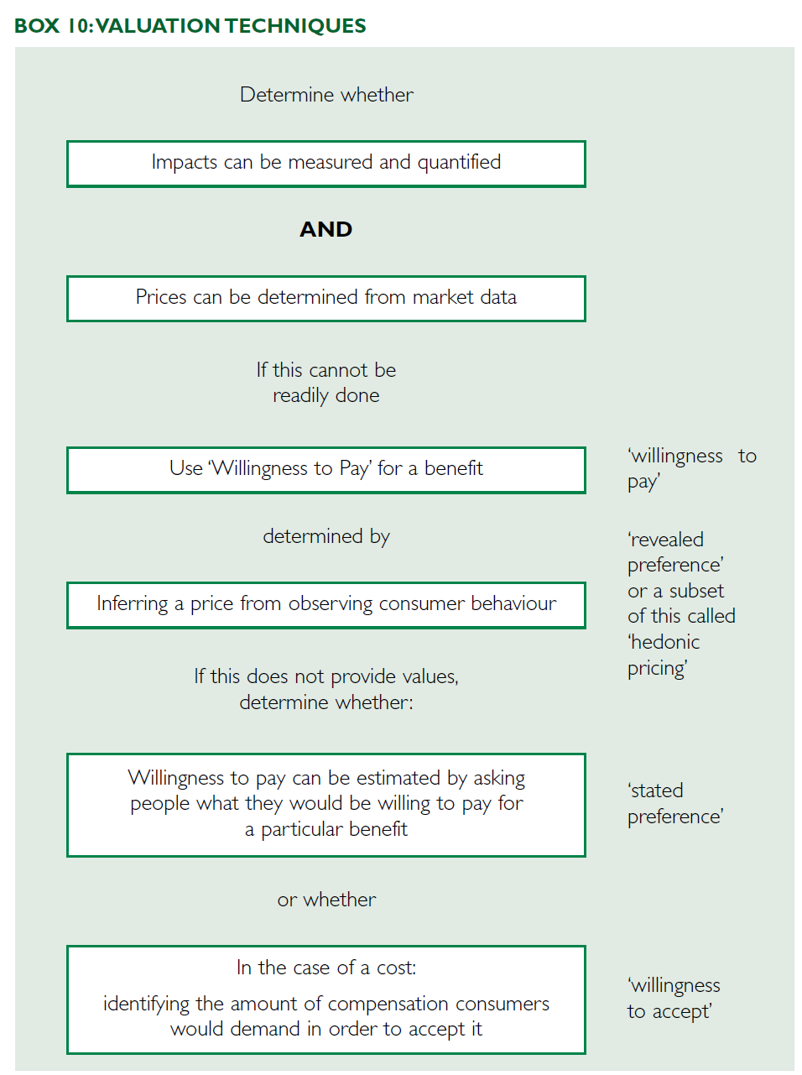

Slide 25
Mission
Objectives
Outputs
Activities
Inputs
Notes:
Thinking through and recording the theory of change

Slide 26
Mission
Objectives
Outputs
Activities
Inputs
The long-term goal that describes the net benefit to society

Slide 27
Mission
Objectives
Outputs
Activities
Inputs
The long-term goal that describes the net benefit to society
The intended results for the target stakeholders / beneficiaries
Usually multiple objectives – often relating to each stakeholder group
Objectives can be constructed as a hierarchy

Slide 28
Mission
Objectives
Outputs
Activities
Inputs
The long-term goal that describes the net benefit to society
The intended results for the target stakeholders / beneficiaries
The metrics used to summarise the output from the activities undertaken to achieve each objective
Usually multiple objectives – often relating to each stakeholder group
Outputs linked to each objective
Outputs can be constructed as a hierarchy
Objectives can be constructed as a hierarchy

Slide 29
Mission
Objectives
Outputs
Activities
Inputs
The long-term goal that describes the net benefit to society
The intended results for the target stakeholders / beneficiaries
The metrics used to summarise the output from the activities undertaken to achieve each objective
The activities undertaken to achieve each objective
Usually multiple objectives – often relating to each stakeholder group
Outputs linked to each objective
Outputs can be constructed as a hierarchy
Objectives can be constructed as a hierarchy

Slide 30
Mission
Objectives
Outputs
Activities
Inputs
The long-term goal that describes the net benefit to society
The intended results for the target stakeholders / beneficiaries
The metrics used to summarise the output from the activities undertaken to achieve each objective
The activities undertaken to achieve each objective
The resources required to undertake the activities to achieve each of the objectives
Usually multiple objectives – often relating to each stakeholder group
Outputs linked to each objective
Outputs can be constructed as a hierarchy
Objectives can be constructed as a hierarchy

Slide 31
Mission
Objectives
Outputs
Activities
Inputs
Impact
Outcomes
Outputs
Process
Inputs

Slide 32
Mission
Objectives
Outputs
Activities
Inputs
Impact
Outcomes
Outputs
Process
Inputs
Description and measurement
Description and measurable targets
Descriptions and metrics
Descriptions
Descriptions and metrics

Slide 33
Mission
Objectives
Outputs
Activities
Inputs
Impact
Outcomes
Outputs
Process
Inputs
Efficiency
Effectiveness
Impact

Slide 34
Log frame - Advantages
Hierarchical structure allows volunteers and employees right through to board members to see individual contributions as well as the whole.
Causal process helps explain strategy and activities.
Facilitates the allocation of costs (time!!) against specific projects, objectives, goals and impact.
Is based on a lifecycle i.e. you set up the framework before embarking on a new program (but can be retro fitted if necessary).
Platform for learning within organisations.
Can be used to explain the rationale for a program to the beneficiaries and funders (“owners”).

Slide 35
Log frame - Disadvantages
Robustness of the logic / causal process is essential – lack of robustness can cause significant problems and undermining of confidence in strategy.
As time passes – internal and external events may undermine the logic / causal process.
Unintended consequences may be significant and distracting.

Slide 36
SROI - Advantages
Focus on impact in addition to outcomes and outputs.
Multi-stakeholder perspectives
Strategic management tool versus measurement tool
Monetises social and economic value in to one measure

Slide 37
SROI - Disadvantages
Misuse of single monetary value
Resource intensive – especially if doing retrospective SROI
Prospective = speculative?
Significant organisational change needed for longitudinal measurement
Case by case development of methodology

Slide 38
Measuring social impact: Next steps
Moving on from the case by case approach
Embedding the measurement of social impact within organisations.
Adoption by audit and accounting profession – Institute of Chartered Accountants Australia
Potential platform provided by “Integrated reporting”
Adoption by “evaluators” and analysts
Scaffolding: - Knowledge integration – templates, models, methodologies, common metrics, system level / shared approaches.

